Slide 1
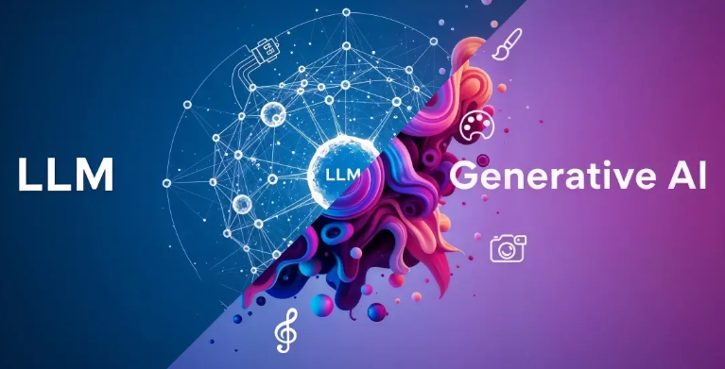

21CSE306P-APPLIED GENERATIVE AI
Industry Supported Professional Elective
B.Tech-5th Sem (2026-27)
Course Project
VERITAS: Evidence-Driven Generative AI for Reliable Research
RA2411003012495 | OM PATHANIA | CTECH
RA2411026010816 | SHASHANK PRASAD | CINTEL
RA2411031010091 | Lakshita Kumarkar | NWC
RA2411031010099 | Aarushi Sarkar | NWC
Faculty Incharge(s) : Dr.Vaishnavi Moorthy & Dr.R.Swathy
Department of Networking and Communications, School of Computing
Notes:
Same font style and template to be maintained throughout
Only title and team details to be edited
SDG logo will differ as per your problem statement

Slide 2
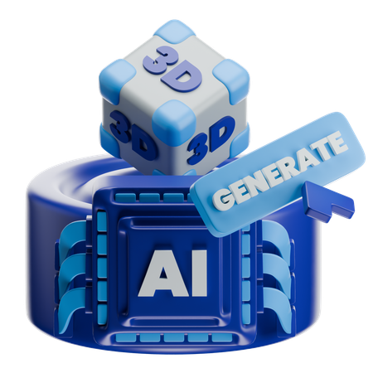
Problem Statement
Generative AI can produce inaccurate or unsupported information with high confidence. Existing AI research tools often lack claim-level verification and conflict detection, making it difficult to assess the reliability of generated information.
Solution
Retrieval-Augmented Generation grounded in trusted source documents
Claim-level verification using NLI against retrieved evidence
Confidence scoring via self-consistency & evidence strength
Reliable, citation-backed research reports
Notes:
Only crisp an to the point to be mentioned…. Keywords may be made bold

Slide 3
Pipeline Diagram
VERITAS: Retrieval-Augmented Generation with Claim-Level Verification
KNOWLEDGE INDEXING
(offline, one-time)
I1. Source Documents
Trusted Corpus
Papers, reports, PDFs
Uploaded by the user
I2. Chunking
Parse & Split
Clean extracted text
Chunks + page metadata
I3. Vector Index
Embeddings + Storage
Sentence-Transformer vectors
FAISS / ChromaDB
Why this is Generative AI (not Agentic AI)
Core work is in the models: LLM generation, embeddings, NLI and self-consistency sampling
Fixed, single-pass pipeline: no autonomous agents, planning or tool-use loops
semantic search
GROUNDED GENERATION
(RAG)
1. User Query
Research Question
Natural-language question
Answered from the corpus
2. Query Embedding
Encode Query
Same model as the index
Dense query vector
3. Retrieval & Re-ranking
Find Evidence
Top-k semantic search
Cross-encoder re-ranking
4. Grounded Prompt
Evidence-Constrained
Query + top passages
Rule: cite every claim
5. LLM Generation
Grounded Answer
Draft answer from evidence
Inline [source] citations
draft answer with citations
VERIFICATION & SCORING
(hallucination check)
6. Claim Extraction
Atomic Claims
LLM splits answer into single facts
Each claim keeps its citation
7a. NLI Evidence Verification
DeBERTa-v3 NLI checks each claim against its cited passage → Supported / Contradicted / Unsupported
8. Confidence Scoring
& Conflict Detection
Fuse NLI + consistency scores
Flag contradicting sources
Weak claims regenerated once
9. Verified Report
Final Output
Answer + citations
Per-claim verdict & confidence
Conflict summary
7b. Self-Consistency Check
LLM re-sampled N times; claims that are not reproduced consistently are flagged as likely hallucinations
Tech Stack: Python | Hugging Face Transformers | Sentence-Transformers | FAISS / ChromaDB | DeBERTa-v3 NLI | Generator LLM (Llama-3 / GPT-4o-mini) | Streamlit UI
Notes:
Neatly first version of pipeline to be prepared demonstrating modules--strictly not generated from any LLM or google images to be incorporated. Number the steps accordingly…. DO NOT USE FLOWCHART symbols and logic in pipeline diagram (e.g. decision box, etc)----Remove Sample logo in your version
Avoid canva generated diagram

